Slide 1
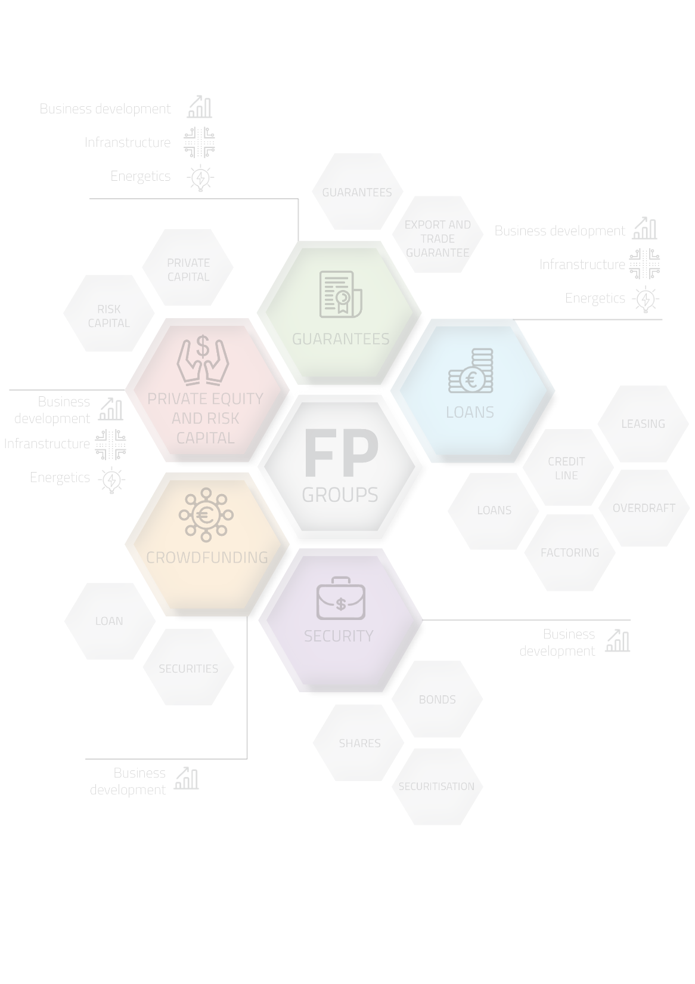

THE MAP OF FINANCIAL PRODUCT‘S
26th of January, 2018
Evaluation was performed in accordance with the service provision contract No. 14P-56 „Referring to Financial Product Evaluation in Lithuanian Market Creating a Product Supply Map“ signed on August 01, 2017 between Ministry of Finance of the Republic of Lithuania and LLC „VG CONSULT“

Slide 2
CONTENT
Introduction;
Methodology of Lithuanian financial products‘ map developmet;
Results of financial products’ market research and evaluation of financial products’ map conception;
Map of financial products‘;
Conclusions.

Slide 3

INTRODUCTION
The aim of the evaluation is to assure integrity of the created/expected to be created financial instruments established by the EU structural funds with other measures active in the market, and increase their efficiency.
The object of evaluation is financial products in Lithuania. This work analyses financial products designated for expansion of business, public infrastructure and increase of energy efficiency.
The map of financial products is the entirety of financial products which is systematised and classified according to various aspects (e.g. according to groups of financial products, suppliers, financed area or expedience, etc.)

Slide 4
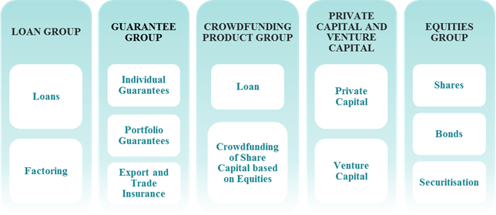
Products of financial market

Slide 5
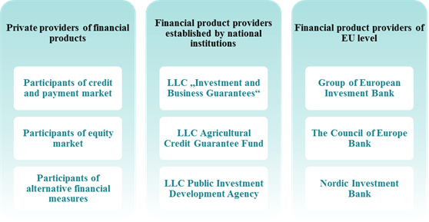
Providers of financial products

Slide 6
METHODOLOGY OF LITHUANIAN FINANCIAL PRODUCTS‘ MAP DEVELOPMENT

Slide 7
METHODOLOGY OF LITHUANIAN FINANCIAL PRODUCTS‘ MAP DEVELOPMET
Financial product market research analysis methodology
The aim is to analyze the financial products market in Lithuania.
Respondents are companies that have taken advantage of financial products.
Quantitative research methods.
310 questionnaires received.
Methodology for evaluating the concept of financial product map
The aim is to deepen knowledge about the expectations of financial market participants regarding the map of financial products.
Qualitative research methodology – two focus group discussions organised.
Selection of participants - targeted.

Slide 8
ANALYSIS OF FINANCIAL PRODUCTS‘ MARKET AND EVALUATION OF FINANCIAL PRODUCT S‘ MAP CONCEPTION

Slide 9
Results of financial product market survey and their analysis
Companies by years of activity
Most companies that work for 5 years or more indicated that they are mature or growing companies and only one company operating from 5 to 10 years belonged to the development and start-up phase.
Most of the young companies (up to 5 years of age) were also in the growth stage (63 out of 98), almost every fifth company (20 out of 98) was at the start-up stage, 12 companies were at the seed stage and only two companies belonged to mature businesses.
86.7% of the surveyed companies belong to mature or growth stages and 11.6% of respondents own the stage of development or start-ups.
Most of respondents operated in the market for more than 10 years (42.2%), almost a quarter of respondents were the companies operating from 5 to 10 years, and one third of respondents were the companies operating for less than 5 years.
Companies by stage of activity

Slide 10
Respondents by area of activity
The vast majority of respondents came from the service sector (59%) and the manufacturing sector (27.7%).
Also, 4 educational institutions, two apartment associations, one cultural institution and other enterprises (trade, financial services, engineering services, creative industries, the medical sector, legal services, transport services, education services, water supply and wastewater treatment services, and land farm enterprises) participated in the survey.

Slide 11
The problems of business development and their importance
Notes:
We asked what kind of the problems respondents face with in business. What are the most important problems for respondents are the high tax for business, increasing personell cost, lack of finacial resources.

Slide 12
Demand of financial products
Notes:
While analyse demand of financial products we see that leasing and private resources are the most popular financial products.
Alternative financial products like venture capital, business angels .. Are not so relevant for respondents. This implies that the market of alternative financial products is in only development phase.

Slide 13
The importance of factors for choosing financial instruments
Notes:
What are the most relevant factors for respondents when choosing financial instruments are the low interest rate, favourable repayment conditions, deposit and low contract administration fee.
Good attitude to customer
Low contract administration fee (man atrodo sutarties mokestis taip rasomas)

Slide 14
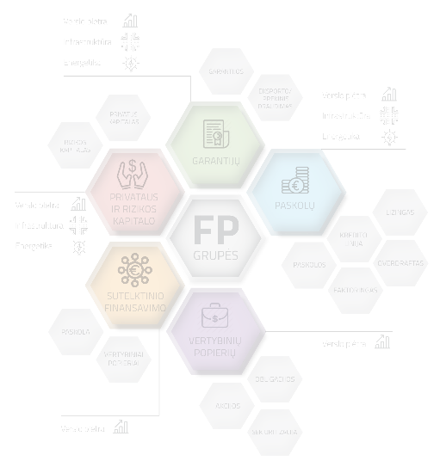
The popularity of financial instruments at different stages of company development
Notes:
The research results discovered what kind of financial intruments are used in different stage of company development. What is the most interesting is that the respondets hardly any use alternative financial products at the seed stage. Hovewer, private resources are the most popular at the this stage.

Slide 15
The popularity of financial instruments at different stages of company development
Notes:
At the start up stage the private resources remain the most popular financing instrument. However, the popularity of loan for new and small enterprises, credit line and credit limit is increasing comparing to seed stage.

Slide 16
The popularity of financial instruments at different stages of company development
Notes:
What is interesting is that the leasing, EU support and credit line are the most popular financial products despite of the private resources.

Slide 17
The popularity of financial instruments at different stages of company development
Notes:
What is interesting while analysing mature stage is that leasing is more popular than private resources. Also, Respondents use EU support, credit limit and credit line. Funding of business angles is not used at all among the respondents. Other alternative financial products are hardly any used for business development.

Slide 18
The impact of financial products on a private sector entity
Notes:
Respondents representing private sector agree that discussed financial products have had positive impact on business development.

Slide 19
The impact of financial instruments‘ on the public sector entity
Notes:
Respondents representing public sector pointed out that discussed financial products have had positive impact on quality of services and company reputation. What is the most interesting is that half of respondents completely disagree that cost on energy and energy efficiency increased.

Slide 20
Evaluation of financial products‘ map conception
Dimensions of financial products‘ map
Product group
Supplier group
Area of financing
Entity status
Entity type
Specific finanacing criteria
Notes:
Two focus groups were set up aiming to discuss and test the Conseption of financial products map. As a result the main Six dimensions important for the map were confirmed by project stakeholders.

Slide 21
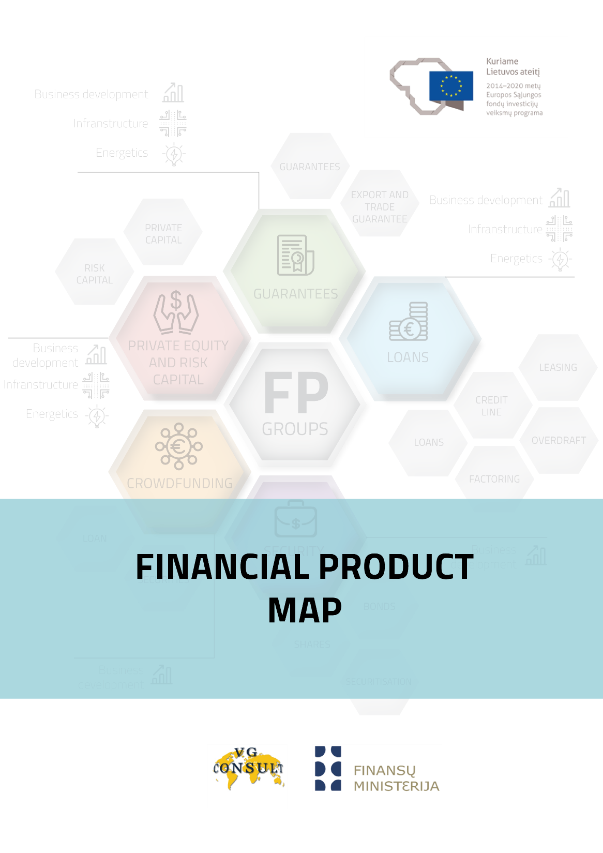
FINANCIAL PRODUCTS‘ MAP

Slide 22
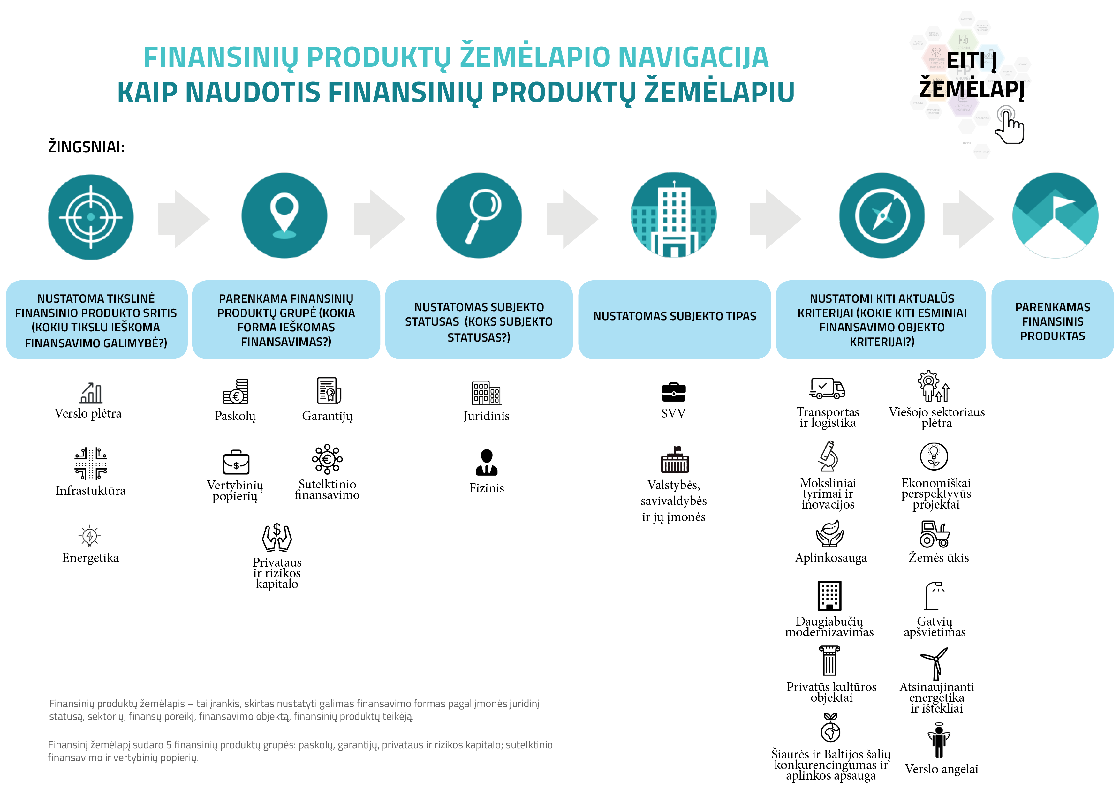
Notes:
The map starts with instruction how to navigate. Firstly, you have to select the are area you are interested in (business, infrastructure development or energy efficiency). After you have to choose group of finanacial product (loans, garantees, securities, private and rsik capital, crwofunding). Next step is for identification of your entity status (legal or individual). After that you have to identify your entity type (SME or public body). And to select the specific criteria related to financed object.

Slide 23
Notes:
securities

Slide 24
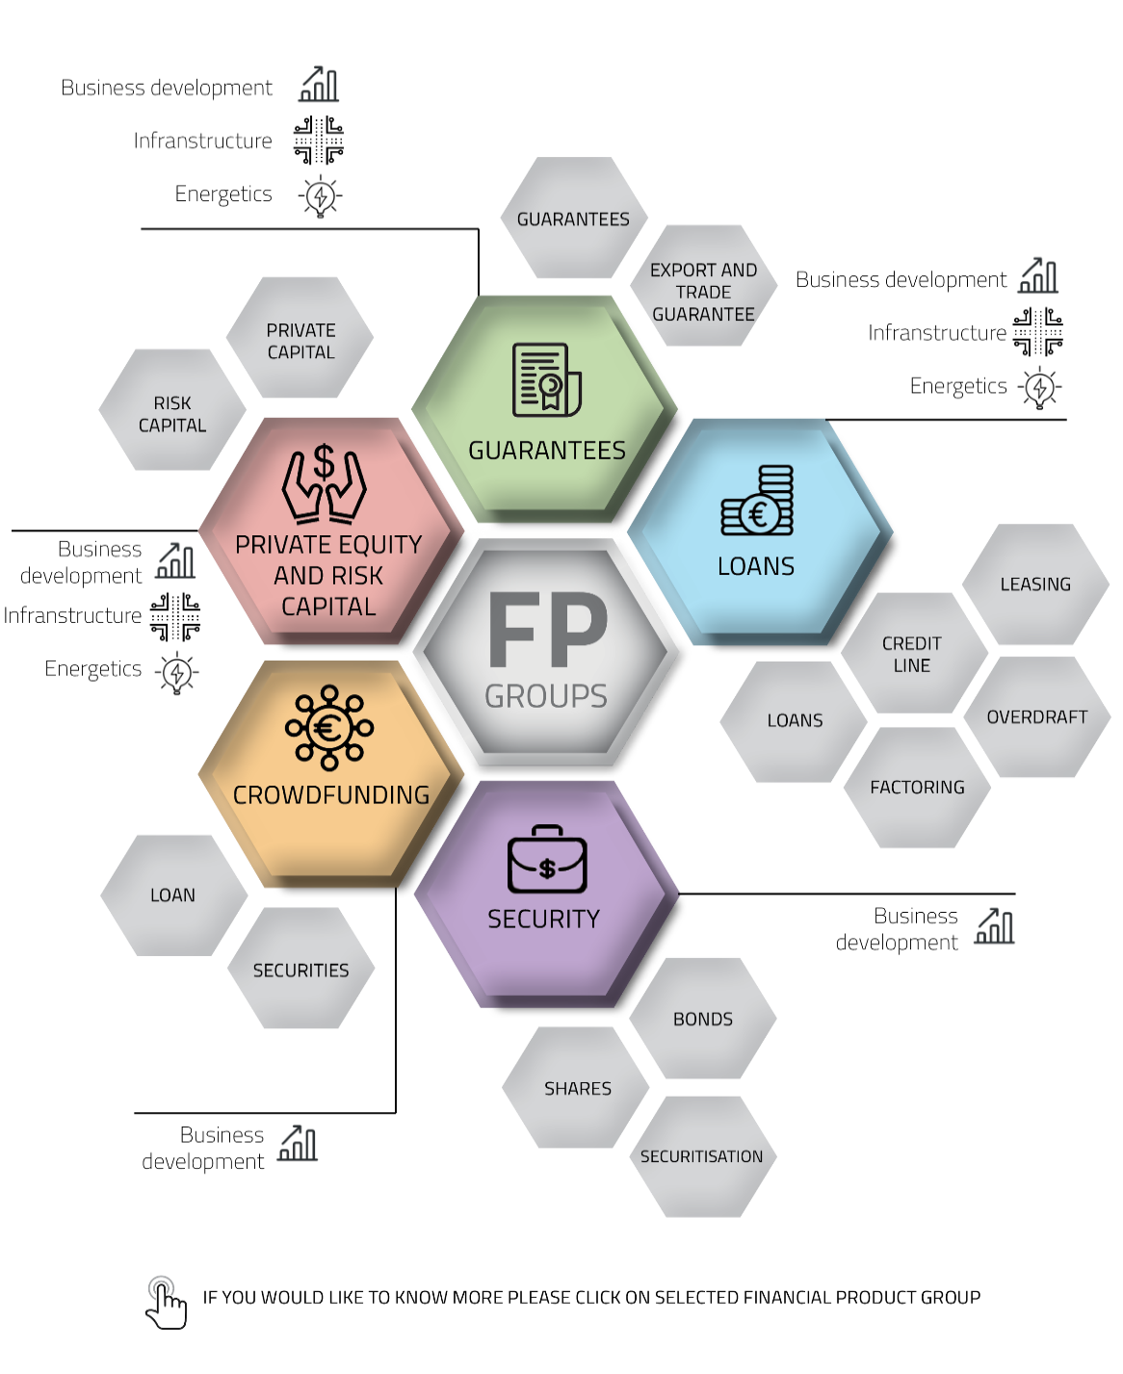
FINANCIAL PRODUCTS‘ MAP

Slide 25
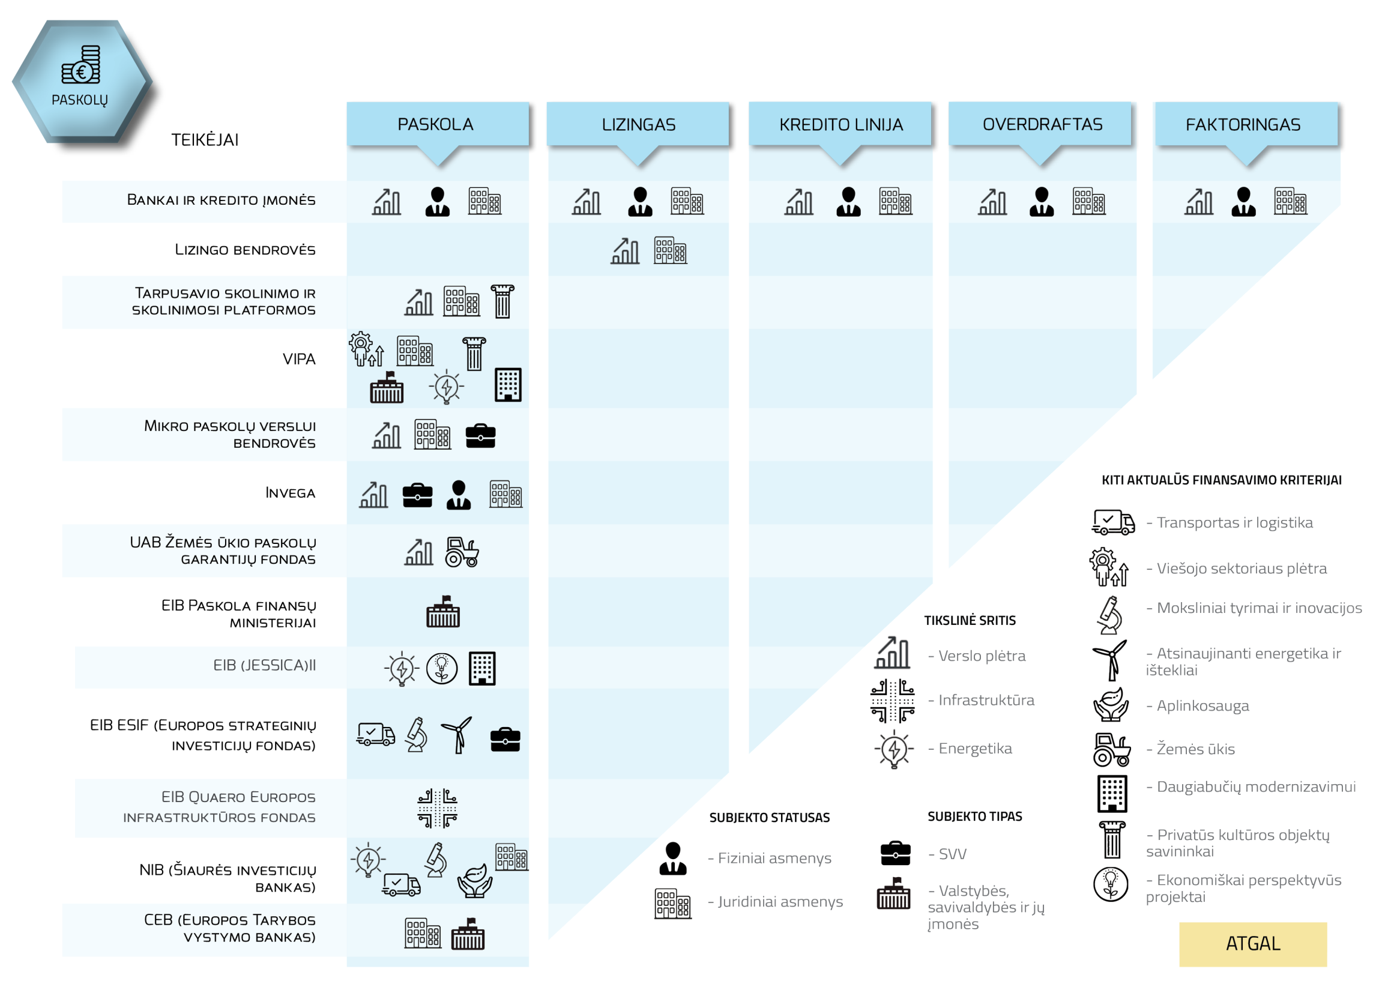

Slide 26
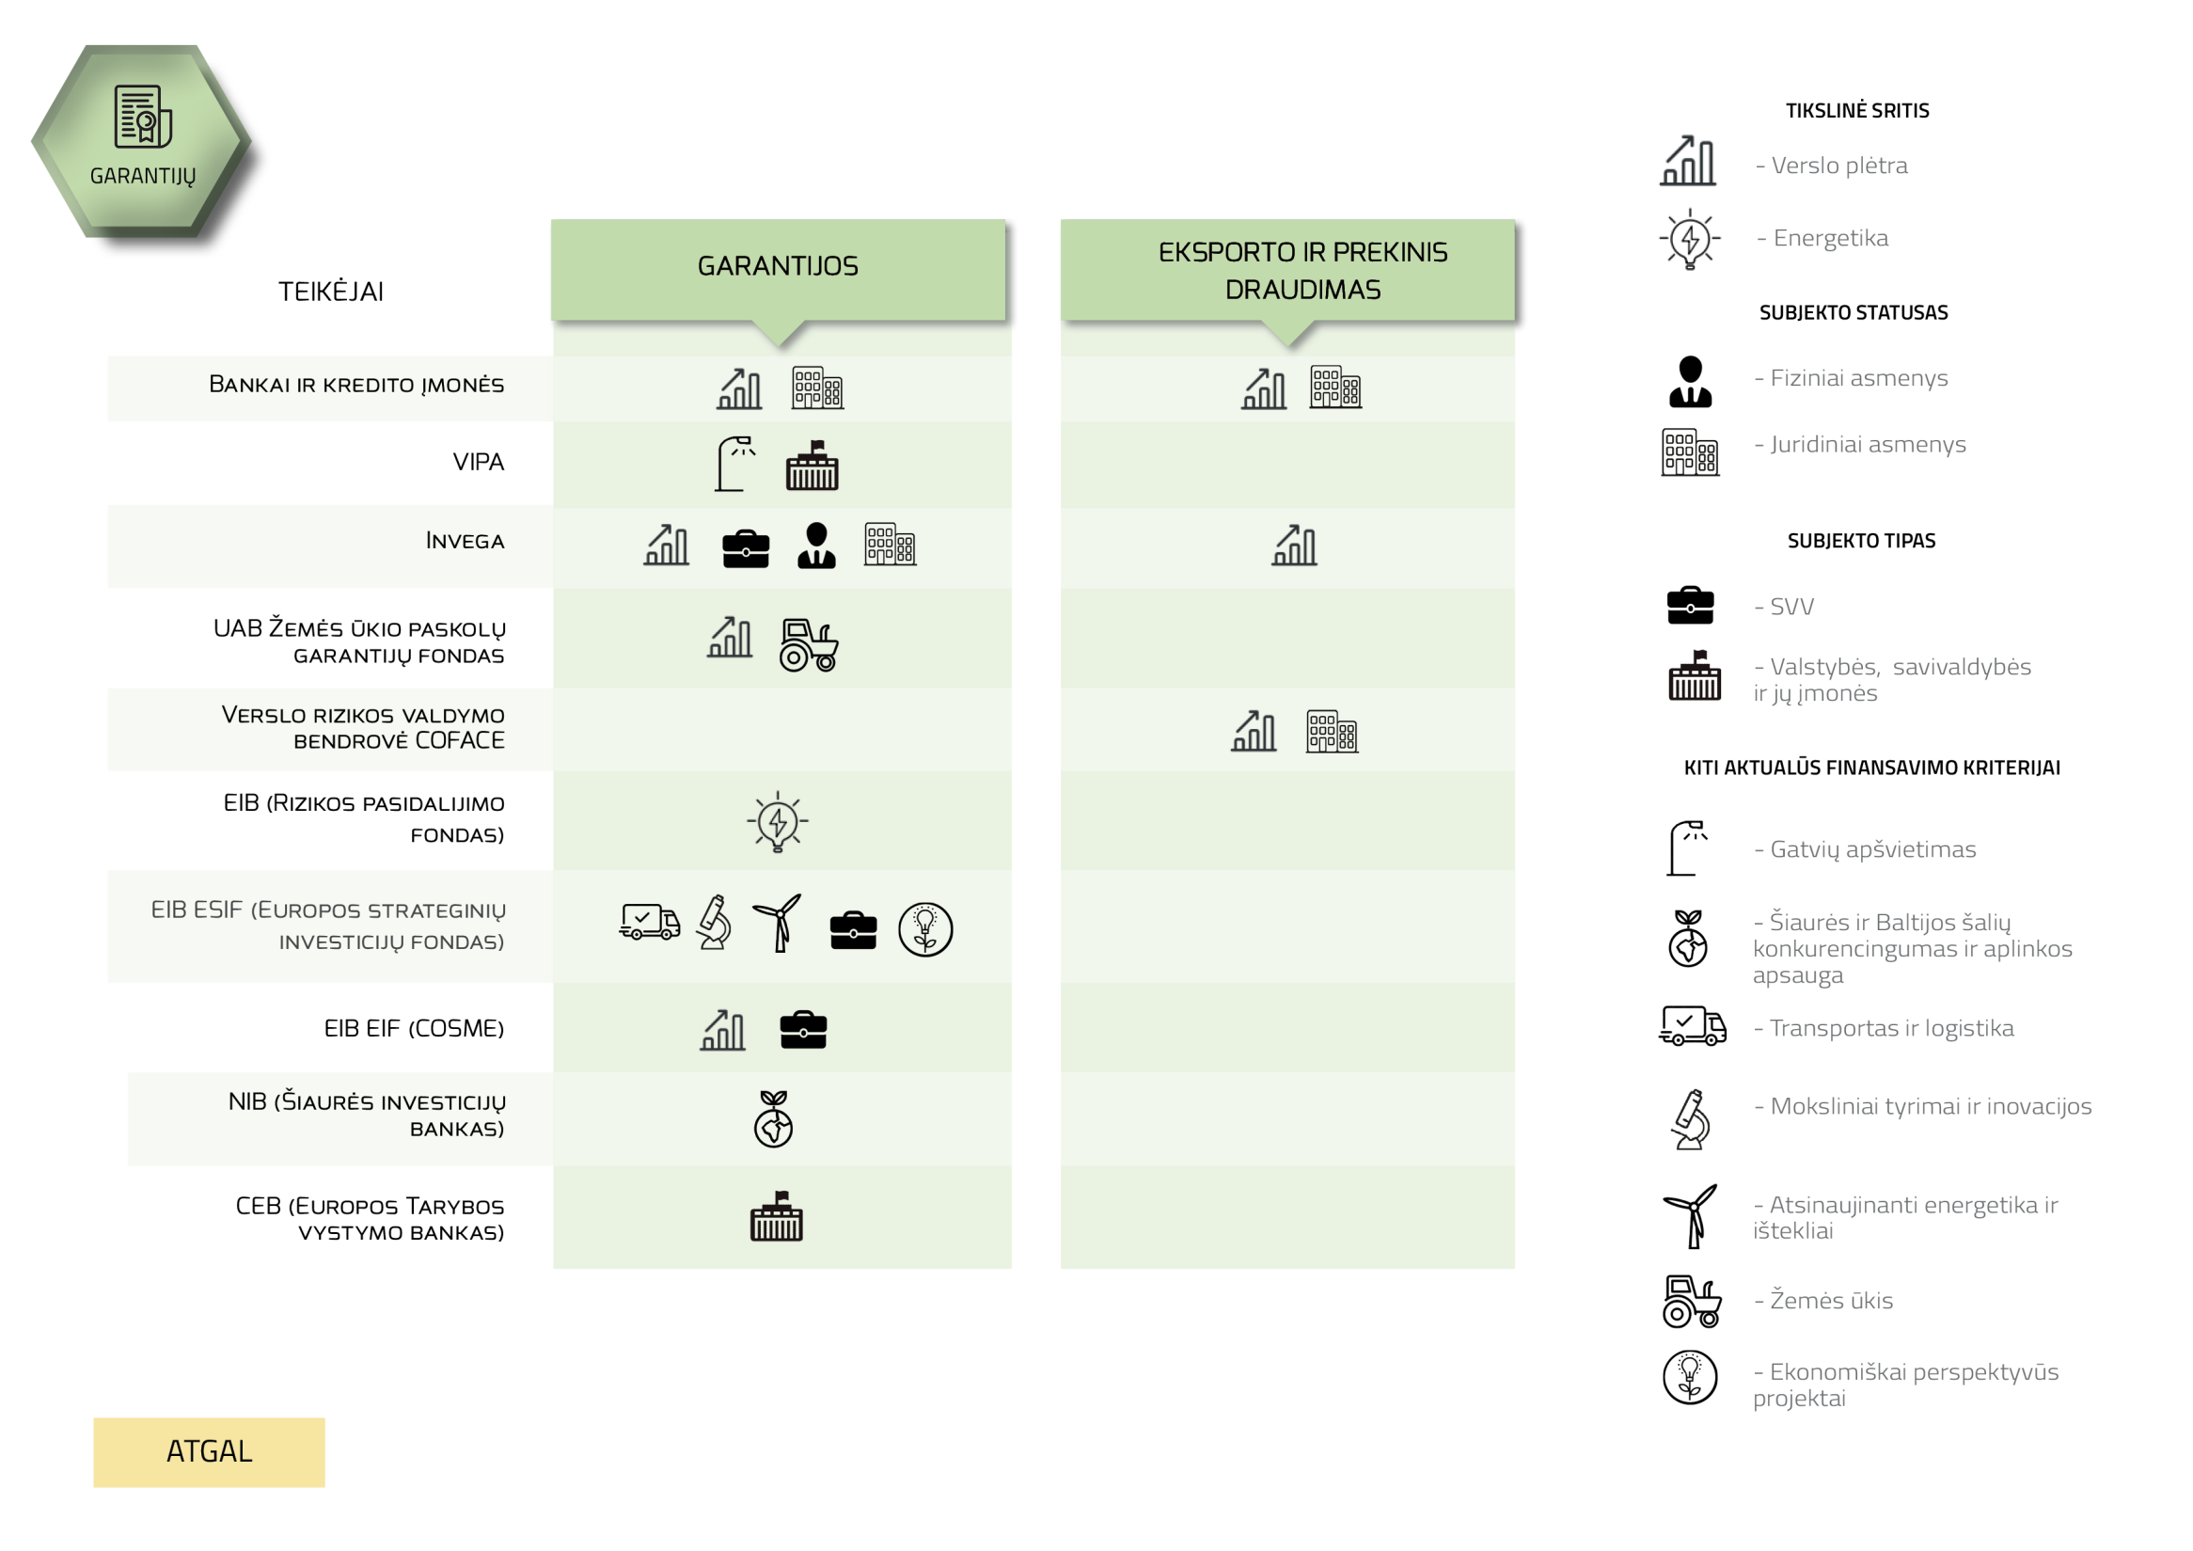

Slide 27
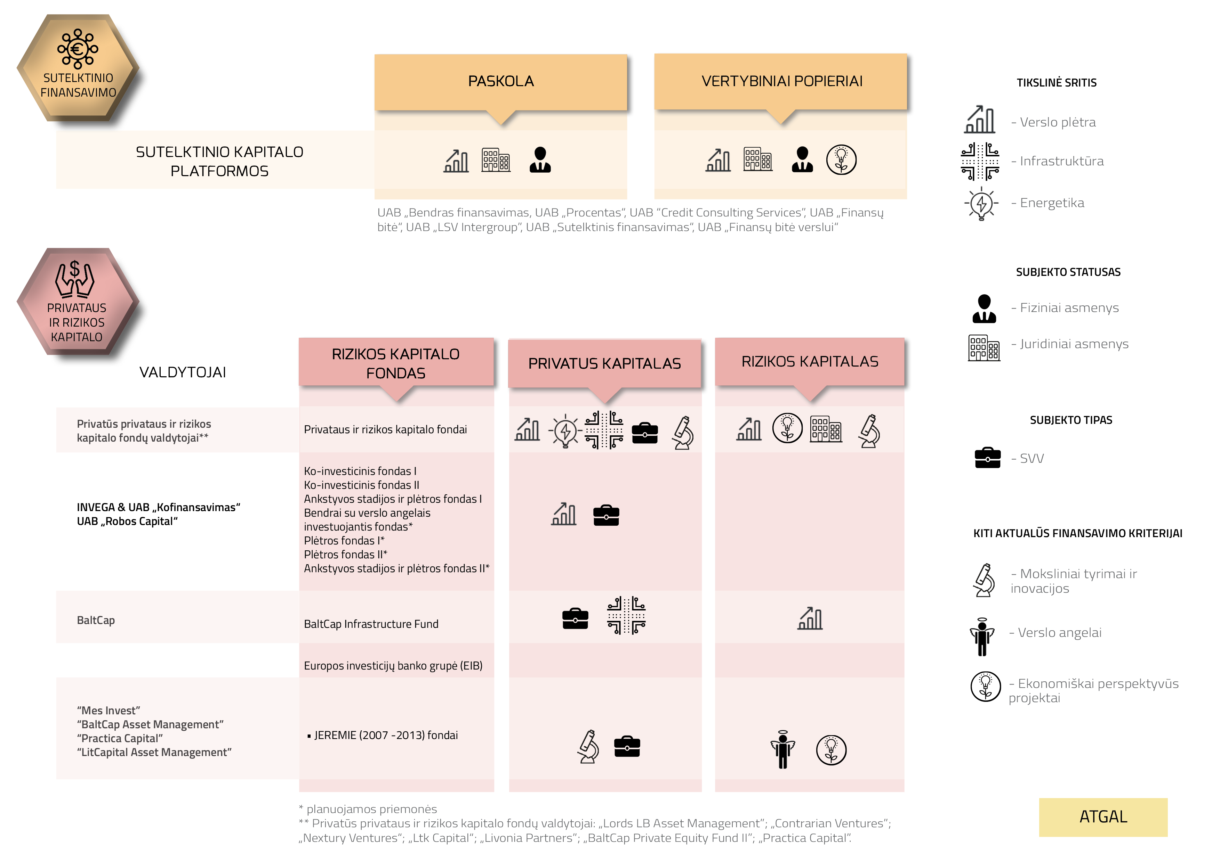

Slide 28
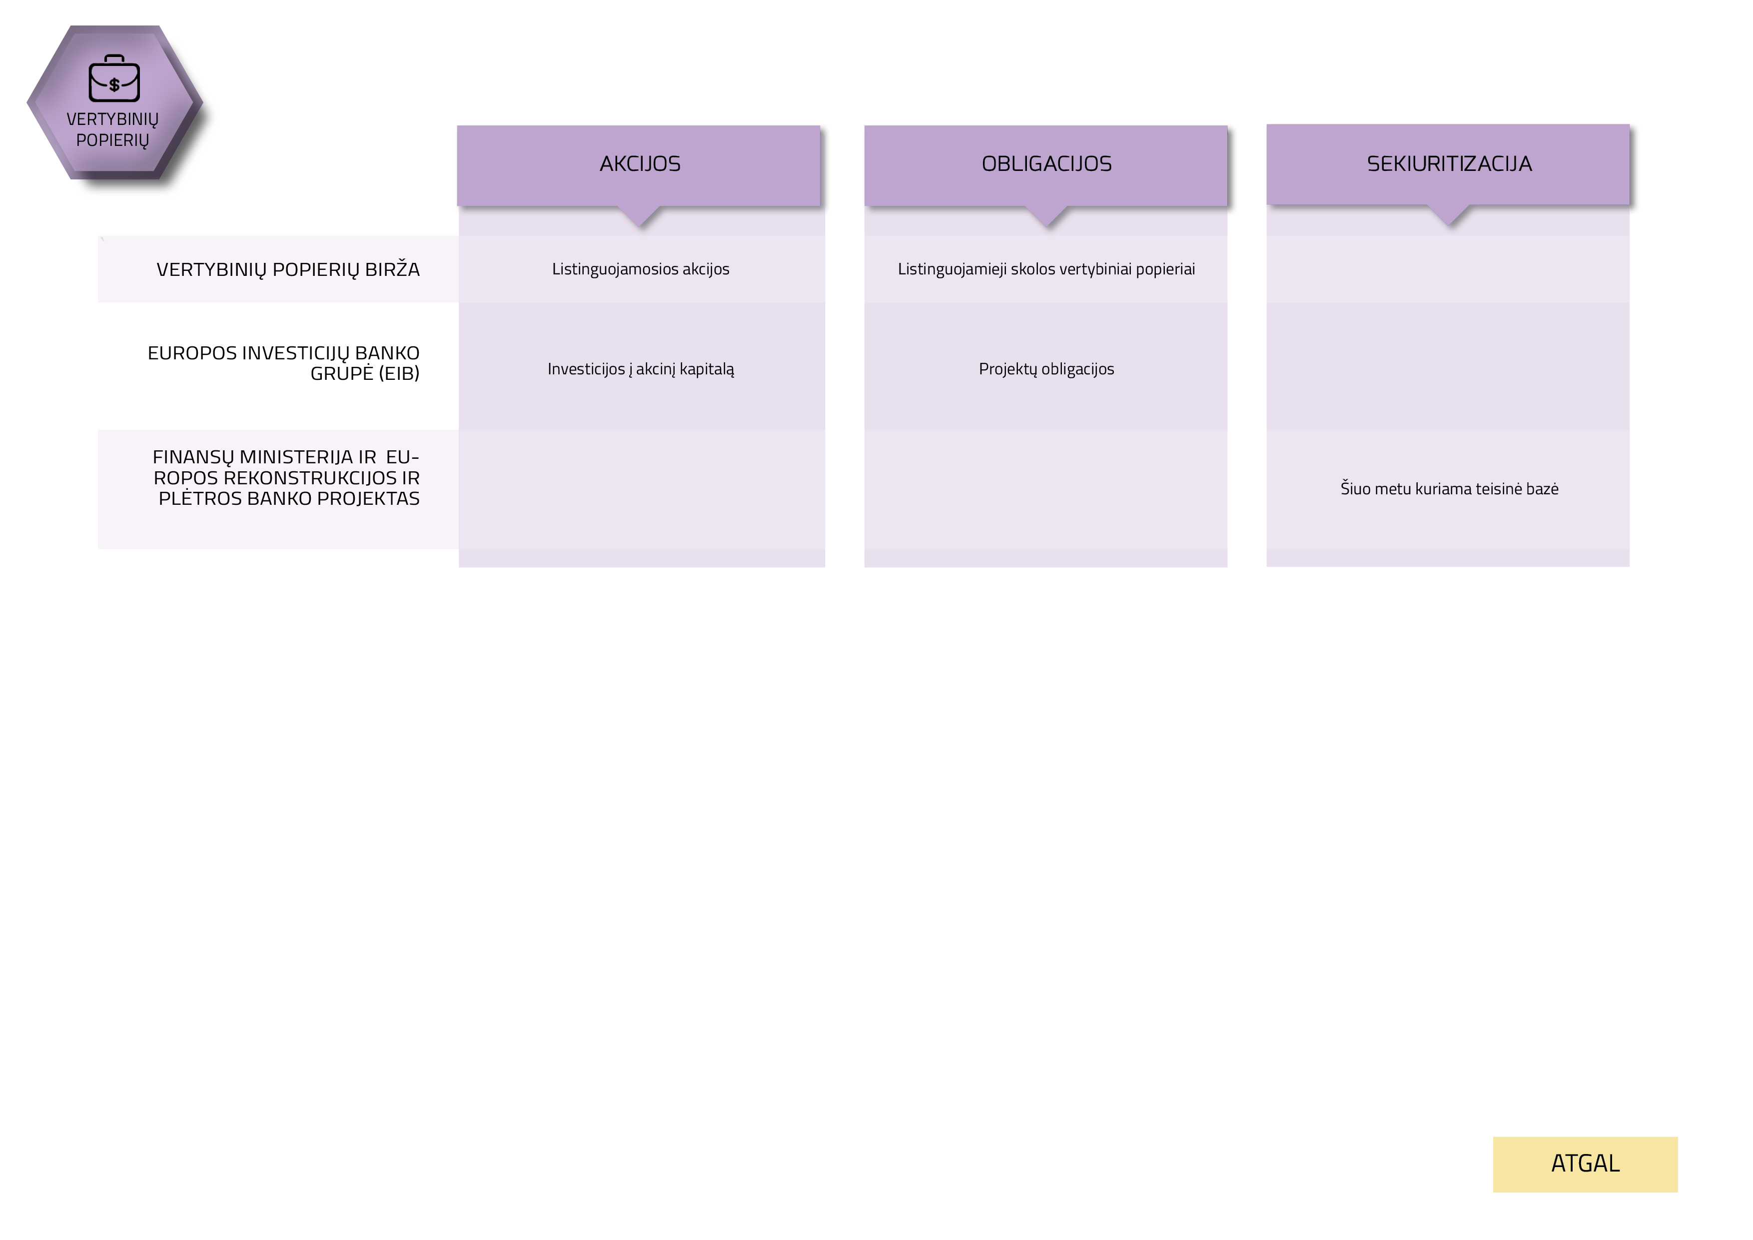
Notes:
Securities. Here you will find shares, bonds
securitization

Slide 29

FINANCIAL PRODUCTS‘ MAP
Innovative approach
Sofisticated tool
Notes:
the map provides an innovative approach of Lithuanian fianacial products market. And can be used as sofisticated tool for desicion making when choosing the relevant financial product.

Slide 30


Ekspertai:
Dr. Rūta Čiutienė
Dr. Alina Stundžienė
Dr. Vitalija Venckuvienė

